Slide 1


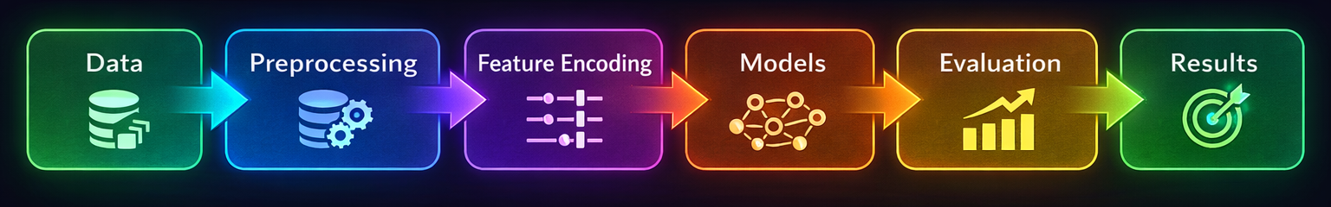
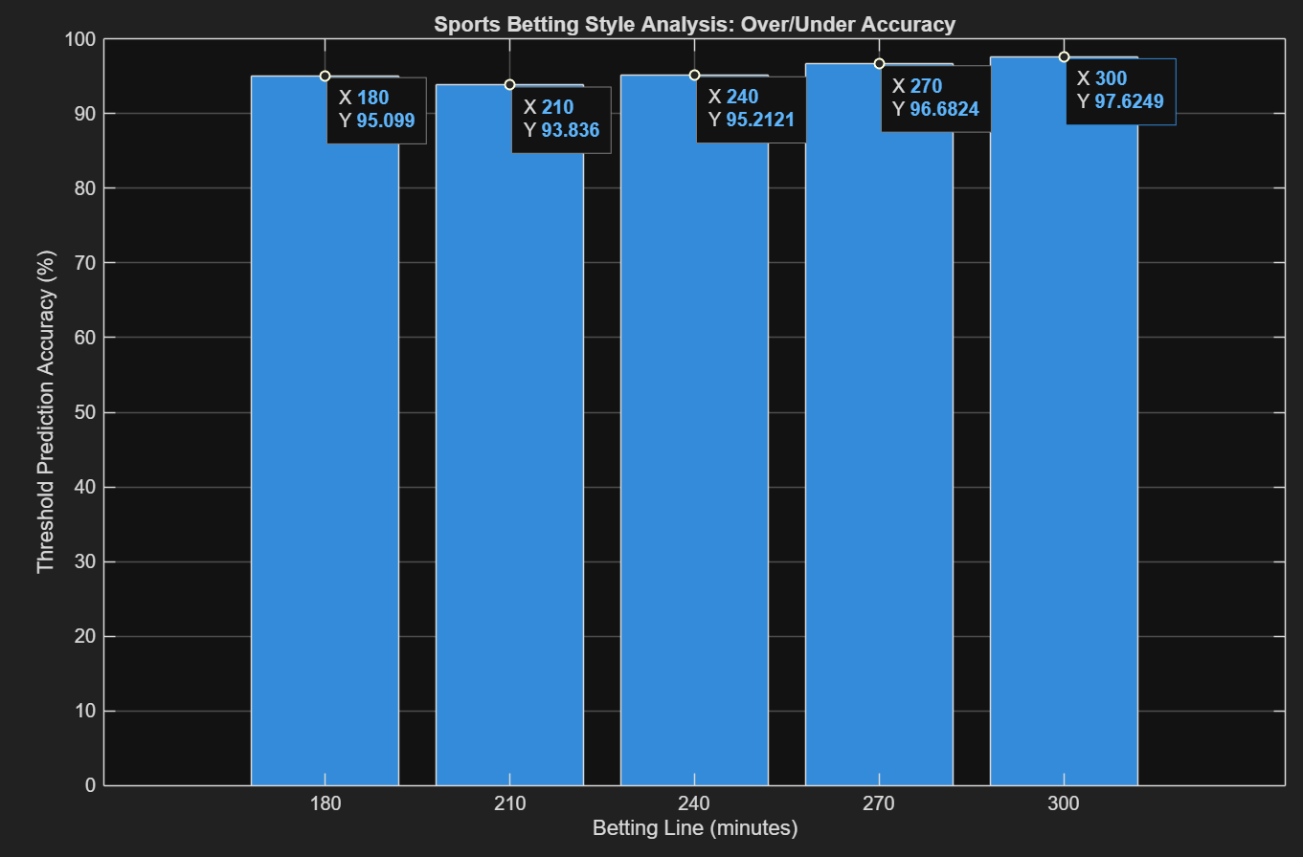
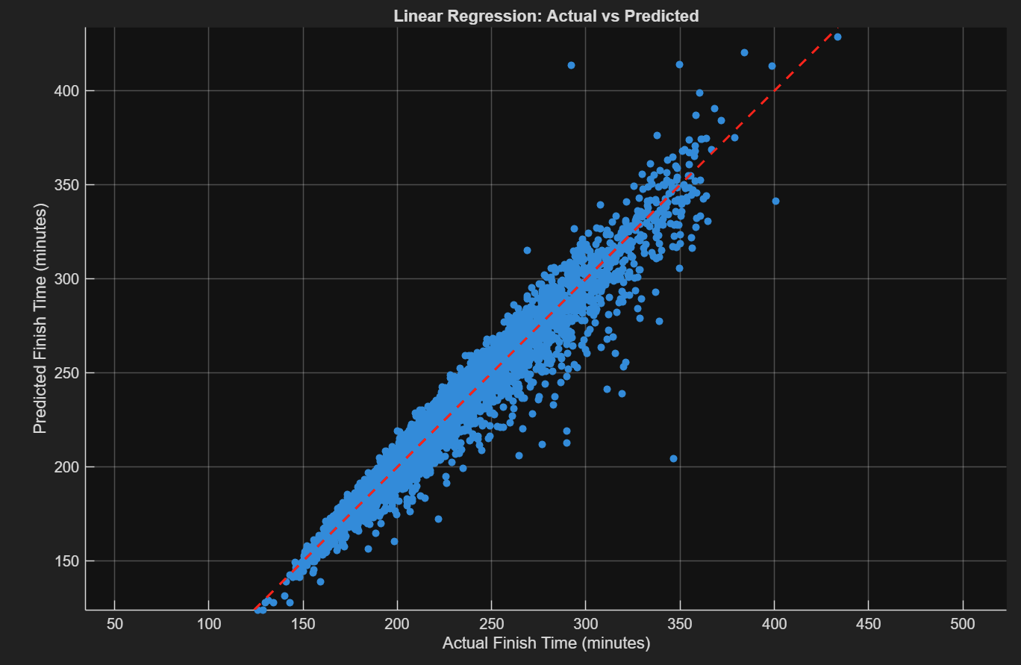
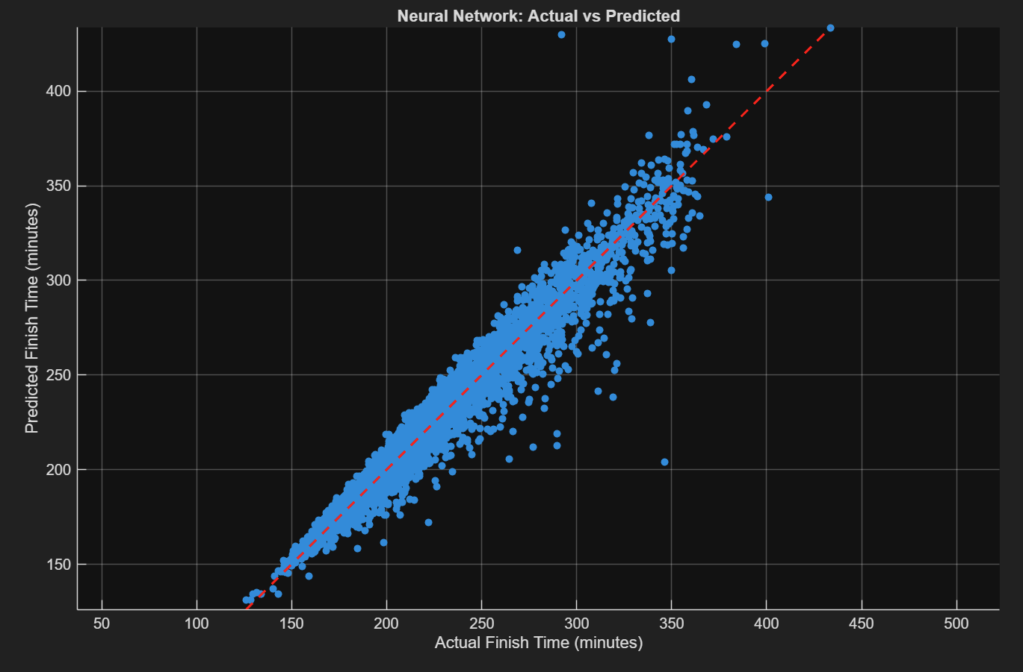
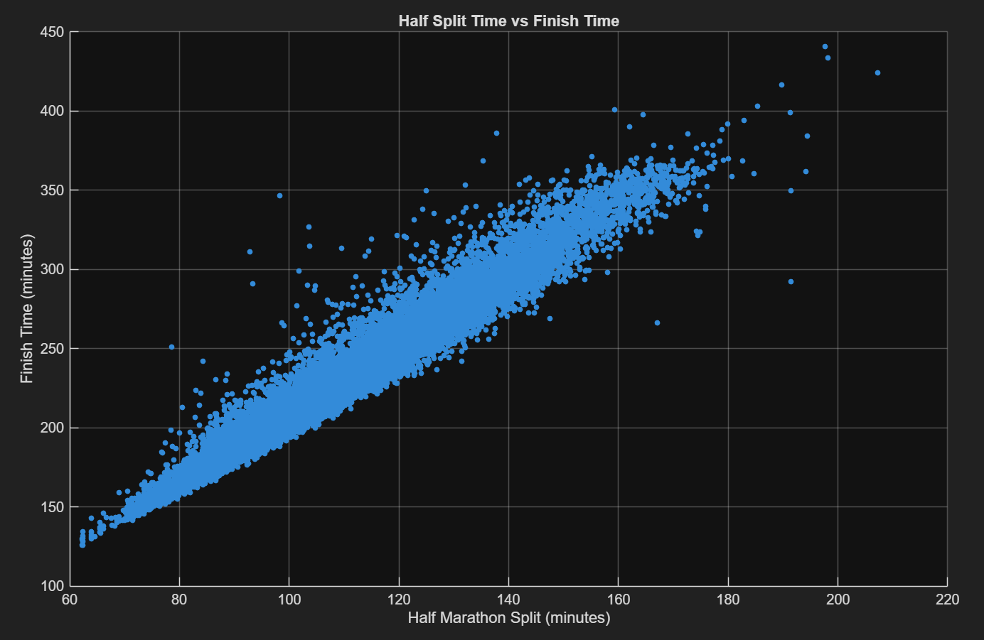
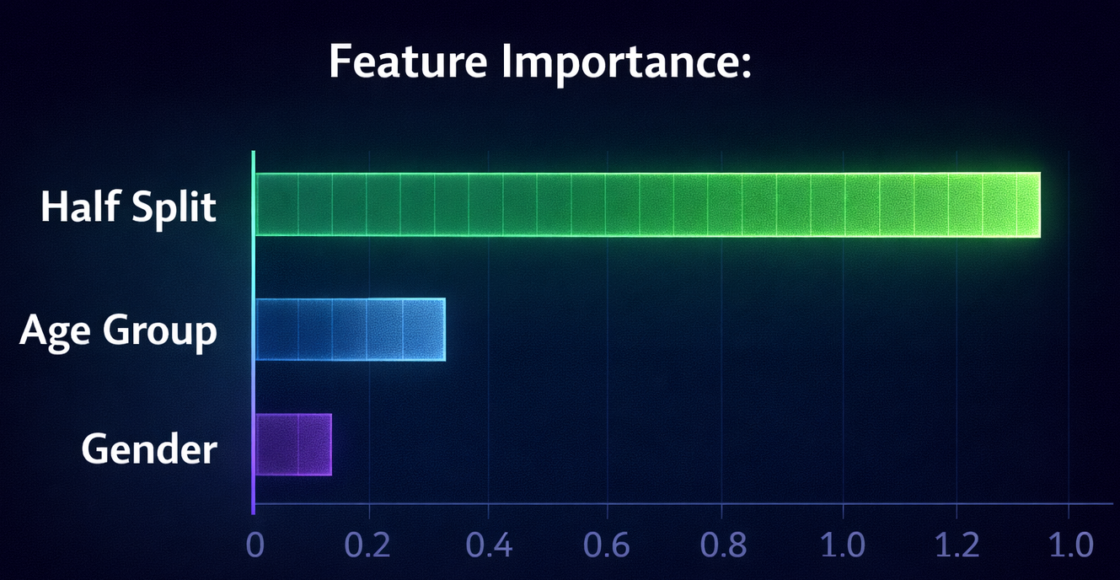
Predicting Marathon Race Performance Using Machine Learning
Sanad Sahawneh, Brian Allen, and Mahib Rahman
College of Nanotechnology, Science, and Engineering
Dr. Hany Elgala / TA Honglan Chen
Department of Electrical and Computer Engineering
Introduction & Motivation
Methodology
Decision-Based Extension
Marathon performance depends on age, gender, and pacing
Goal: Predict marathon finish time using machine learning
Project Objectives
Compare Linear Regression vs Neural Network
Evaluate using MAE, RMSE, R², MAPE
Dataset
2023 Boston Marathon → 26,598 runners
Key Features: age_group, gender, half_time_sec
Target: finish_net_sec
Models
Linear Regression → baseline model
Neural Network (MLP) → captures nonlinear patterns
Convert prediction → Over/Under decision
Thresholds: 180, 240, 300 minutes
Accuracy: ~94–97%
Simulates how models can evaluate and calibrate decision thresholds
This framework converts regression predictions into actionable decision outcomes.
Figure 3. Machine learning pipeline from data processing to final results.
Results
Model | MAE (min) | RMSE (min)
Linear Regression | 6.4066 | 9.1491
Neural Network | 6.3635 | 9.1313
Model Prediction Visualization
Figure 1. Comparison of Linear Regression and Neural Network performance using MAE and RMSE.
Observations
Neural network slightly outperforms linear regression
Both models perform similarly
Feature Relationship
Half-marathon split time shows a strong linear relationship with finish time
Half-marathon split is the dominant predictor
Figure 5. Over/under prediction accuracy across different time thresholds.
Figure 4. Actual vs. predicted marathon finish times for both models. Points close to the diagonal indicate accurate predictions.
Discussion
Key Takeaways
Half-marathon split time is the strongest predictor
Both models achieve high accuracy
Neural network provides slight improvement
Strong linear relationship enables accurate predictions
Neural networks capture additional nonlinear patterns
Future Work
Hyperparameter tuning
Cross-validation
Explore additional ML models
Both models show strong predictive performance accuracy
Neutral network slightly improves accuracy
Points close to diagonal → accurate predictions
Acknowledgments
SCORE Sports Data Repository – 2023 Boston Marathon runners. Provides the full dataset of 26,598 runners, including age group, gender, placements, and half/full marathon times, used for all calculations, graphs, and statistical analysis in the project.
MATLAB (MathWorks) for data analysis and model development.
Figure 2. Half-marathon split time vs final finish time showing strong linear correlation.

